Slide 1
Probabilistic Sensitivity Analysis (PSA)

Slide 2
Sensitivity Analysis
Vary input parameters within plausible ranges
For which values is each strategy optimal?
Deterministic sensitivity analysis (DSA)
One-way analysis: vary one parameter, hold rest fixed
Two-way analysis: vary two parameters, hold rest fixed
Probabilistic sensitivity analysis (PSA)
Simultaneously vary input parameters by randomly sampling from appropriate probability distributions
How often is each alternative cost-effective?
What strategy has the highest expected net benefit?

Slide 3
Input
x₁
x₂
$$⋮$$
x_{j}

Slide 4
Input
Outputs
x₁
x₂
Effect
$$⋮$$
well
sick
dead
Cost
x_{j}
Model
NMB

Slide 5
Input
Outputs
x₁
x₂
Effect
$$⋮$$
well
sick
dead
Cost
x_{j}
Model
NMB

Slide 6
Input
Outputs
x₁
x₂
Effect
$$⋮$$
well
sick
dead
Cost
x_{j}
Model
NMB

Slide 7
Input
Outputs
x₁
x₂
Effect
$$⋮$$
well
sick
dead
Cost
x_{j}
Model
NMB

Slide 8
Input
Outputs
x₁
x₂
Effect
$$⋮$$
well
sick
dead
Cost
x_{j}
Model
NMB

Slide 9
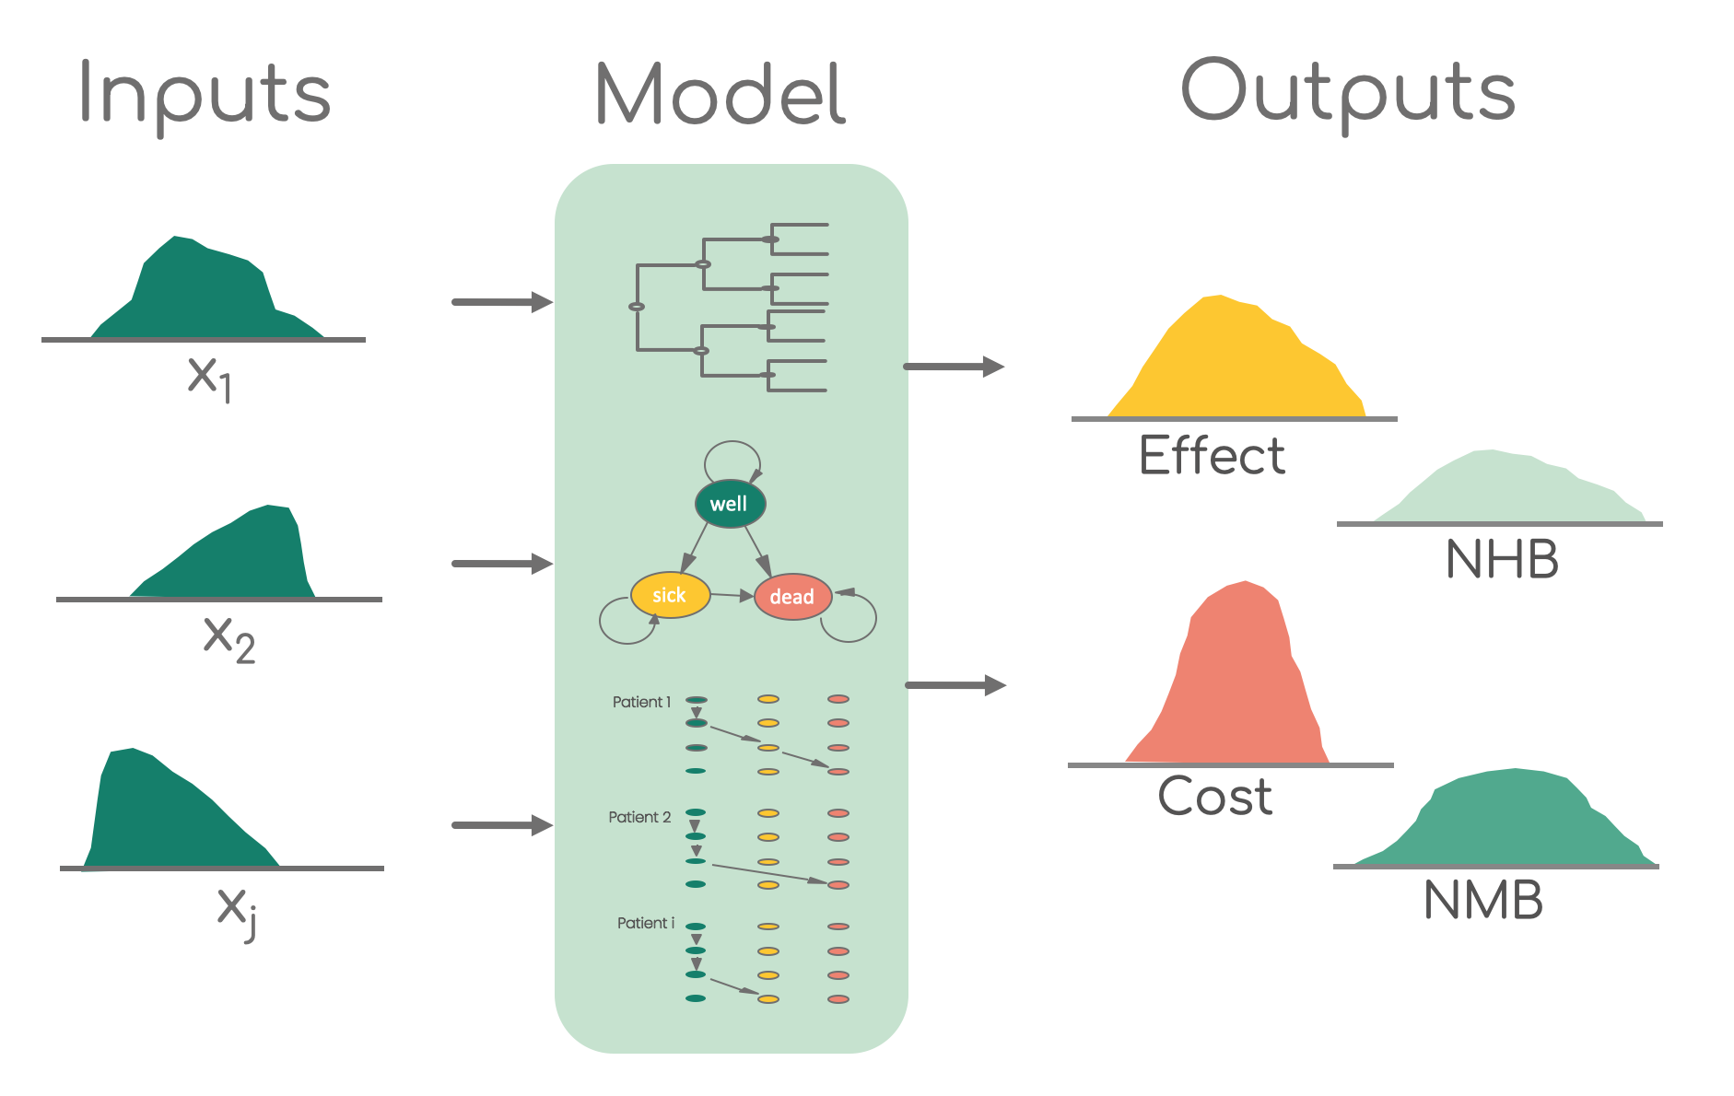
PSA & R
Function which runs the model
using the parameter values from the list
List or data set with parameter
values for each iteration
Data frame with model outcome estimates for each iteration

